Slide 1
Fire Watch

Slide 2
REQUIREMENTS FOR FIRE WATCH
A fire watch is a temporary measure intended to ensure continuous and systematic monitoring of a building, or portion thereof, by one or more qualified individuals for the purpose of identifying and controlling fire hazards, detecting early signs of unwanted fire, raising an alarm of fire and notifying the fire department.

Slide 3
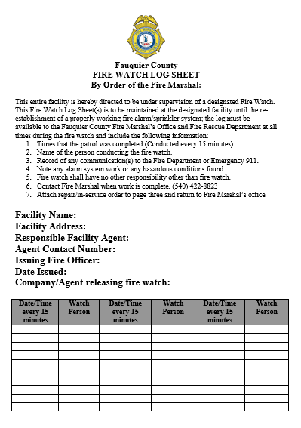
Fire Watch
Within the jurisdiction of Fauquier County, if a fire watch is ordered by the Fire Department or Fire Marshal’s office when a fire protection system is out of service or impaired, the following criteria shall be implemented at a minimum:

Slide 4
Fire Watch
A fire watch shall be established and maintained throughout the building. The fire watch shall be performed by responsible individuals designated by facility or project management.

Slide 5
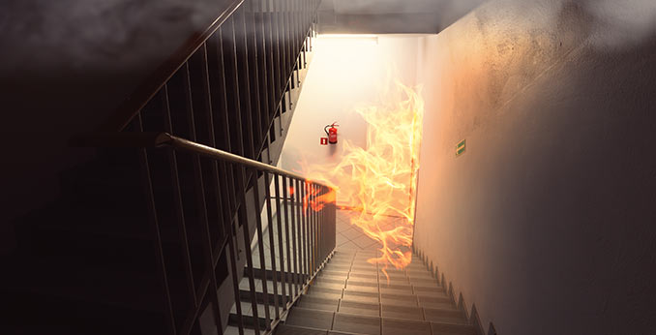
Fire Watch
All areas within every building shall be visually surveyed on a continuous basis and inspected for any visual evidence of heat, smoke, or fire; and to verify that exits are open and accessible.

Slide 6
Fire Watch
The number of persons required to perform fire watch will be sufficient that the entire building can be checked every fifteen minutes.

Slide 7
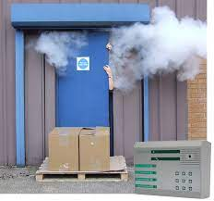
Fire Watch
Individuals performing fire watch shall verify that all exit doors, exit access, and exit discharges are unobstructed and functional, and shall have the authority to remedy any conditions affecting egress.

Slide 8
Fire Watch
Personnel assigned to fire watch responsibilities shall have no other responsibilities other than that of conducting the fire watch and must be fully capable of performing the duties associated with a fire watch.

Slide 9
Fire Watch
If there is an emergency immediately dial 9-1-1 and report the emergency.
NOTE: When dialing 9-1-1 from a cellular phone, some cellular phone systems may connect the caller with another jurisdiction's emergency communications center, therefore the caller should confirm they are speaking with the "Fauquier County" emergency communications center.

Slide 10
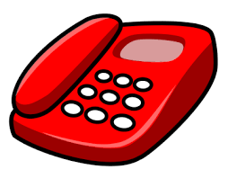
Fire Watch
Personnel performing the fire watch shall have a means of communication that will allow them to immediately convey an alarm condition to the other member(s) of the fire watch.

Slide 11
Fire Watch
A fifteen minute log, including date, time, the locations checked, and the name(s) of the person(s) conducting the fire watch shall be maintained.

Slide 12
Fire Watch Log Sheet

Slide 13
Fire Watch Log Sheet
Facility Name: | Golden Apt.
Facility Address: | 12345 Forty St
Responsible facility Agent: | Mr. Smith
Agent Contact Number: | 540-555-5555
Issuing Fire Officer | Lt. Chance
Date Issued | 1-2-2022
Company /Agent Releasing Fire watch | ADT / John Doe

Slide 14
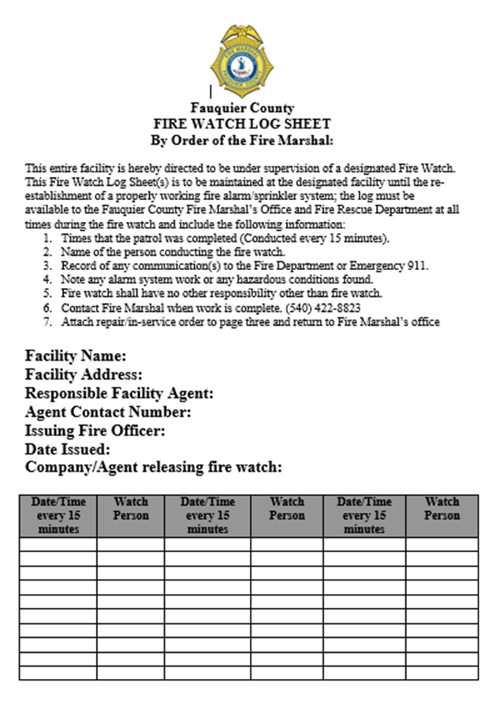
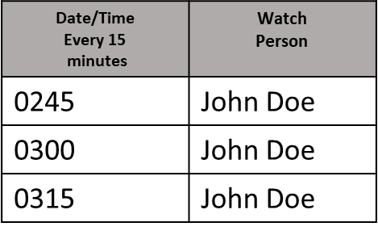
Fire Watch Log Sheet

Slide 15
Fire Watch Log Sheet
Top Copy: Original for Fire Marshals Office
Middle Copy : Issued
Bottom Copy: Return to the Fire Marshals Office

Slide 16
Fire Watch
If there are any questions, please call the Fauquier County Fire Marshal’s office at the numbers listed below.
For Fire and Rescue Emergencies Dial 9-1-1 Fauquier County Joint Communications
Captain /Fire Marshal
Russell Baker (540)422-8823

